Slide 1


Slide 2
Chapter 6
The Relational Algebra and Relational Calculus

Slide 3
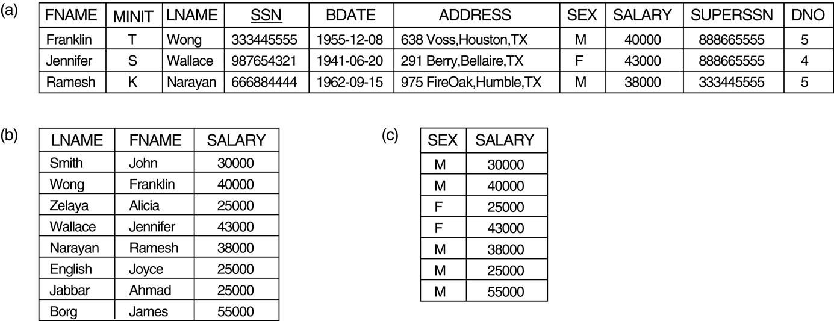
FIGURE 6.1
Results of SELECT and PROJECT operations. (a) σ(DNO=4 AND SALARY>25000) OR (DNO=5 AND SLARY>30000)(EMPLOYEE). (b) π_{SEX, SALARY}(EMPLOYEE).

Slide 4
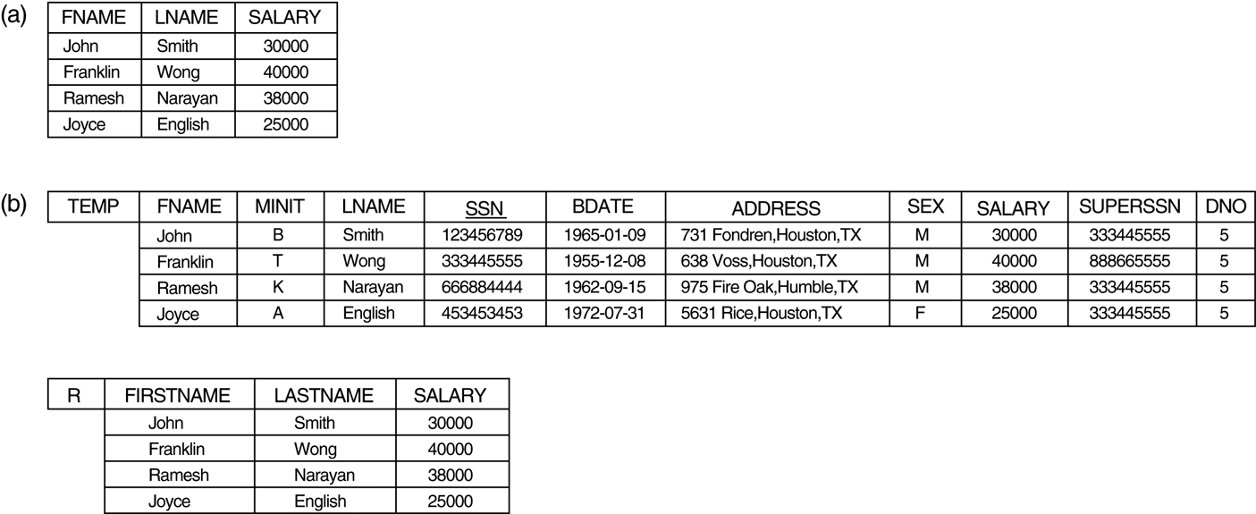
FIGURE 6.2
Results of a sequence of operations. (a) π_{FNAME, LNAME, SALARY}
(σ_{DNO=5}(EMPLOYEE)). (b) Using intermediate relations and renaming of attributes.

Slide 5
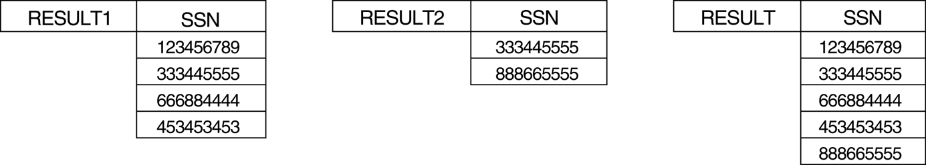
FIGURE≈6.3
Results of the UNION operation RESULT € RESULT1 ∪ RESULT2.

Slide 6
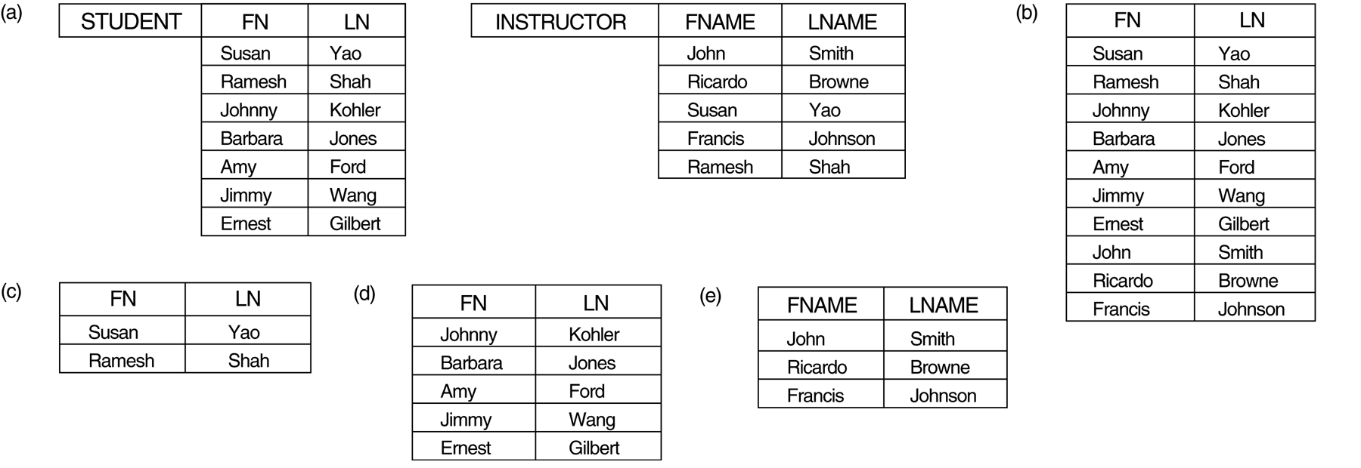
FIGURE≈6.4
The set operations UNION, INTERSECTION, and MINUS. (a) Two union-compatible relations. (b) STUDENT ∪ INSTRUCTOR. (c) STUDENT ∩ INSTRUCTOR. (d) STUDENT – INSTRUCTOR. (e) INSTRUCTOR – STUDENT

Slide 7
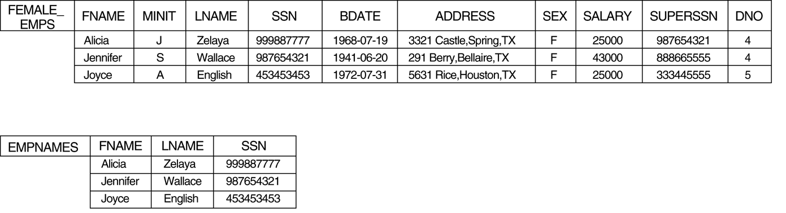
FIGURE≈6.5a
The CARTESIAN PRODUCT (CROSS PRODUCT) operation.

Slide 8
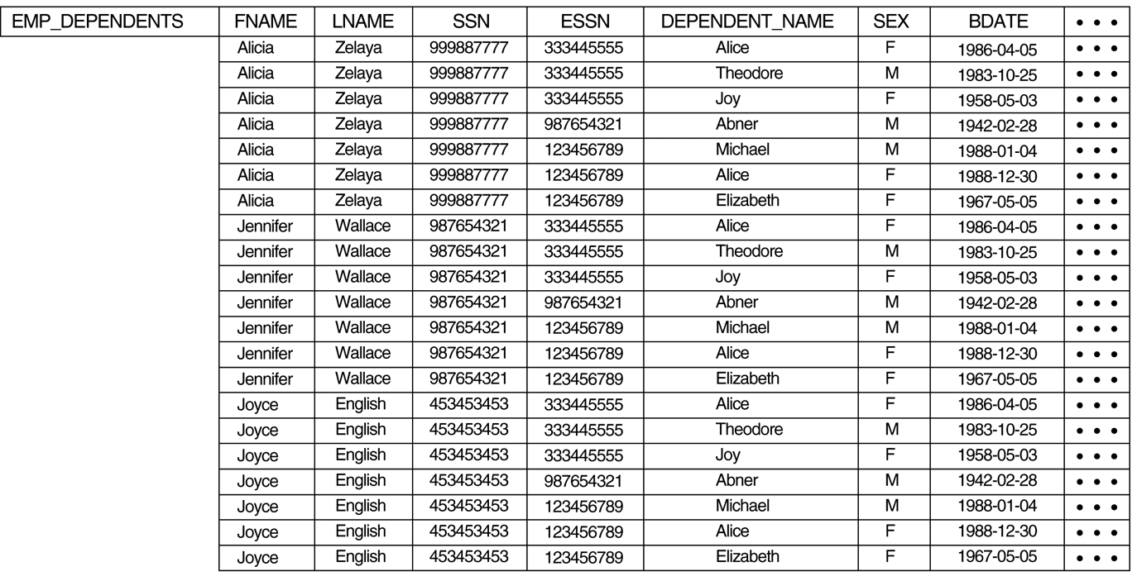
FIGURE≈6.5b
The CARTESIAN PRODUCT (CROSS PRODUCT) operation.

Slide 9
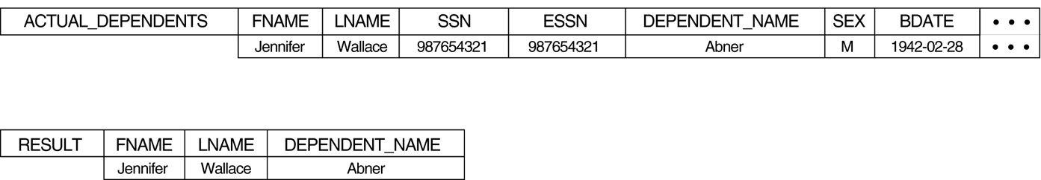
FIGURE≈6.5c
The CARTESIAN PRODUCT (CROSS PRODUCT) operation.

Slide 10
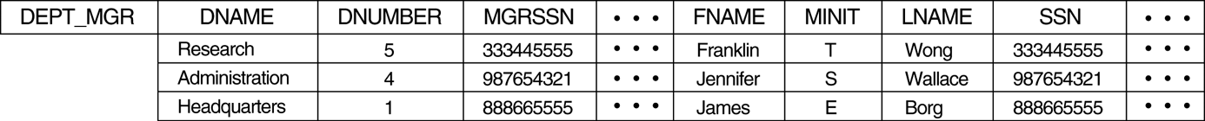
FIGURE≈6.6
Result of the JOIN operation DEPT_MGR ← DEPARTMENT JOIN _{MGRSSN=SSN} EMPLOYEE .

Slide 11
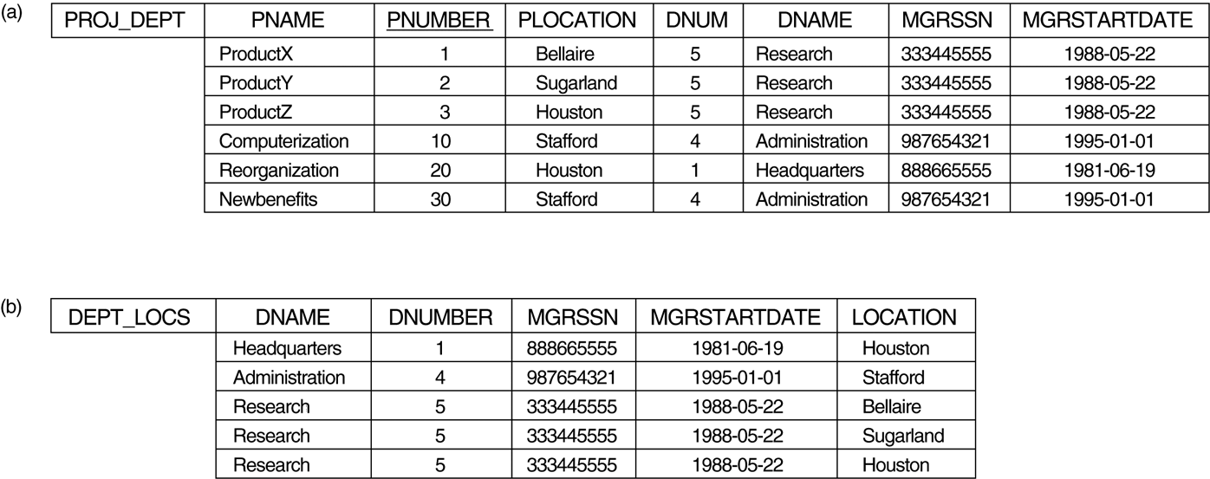
FIGURE≈6.7
Results of two NATURAL JOIN operations. (a) PROJ_DEPT ← PROJECT * DEPT. (b) DEPT_LOCS ← DEPARTMENT * DEPT_LOCATIONS.

Slide 12
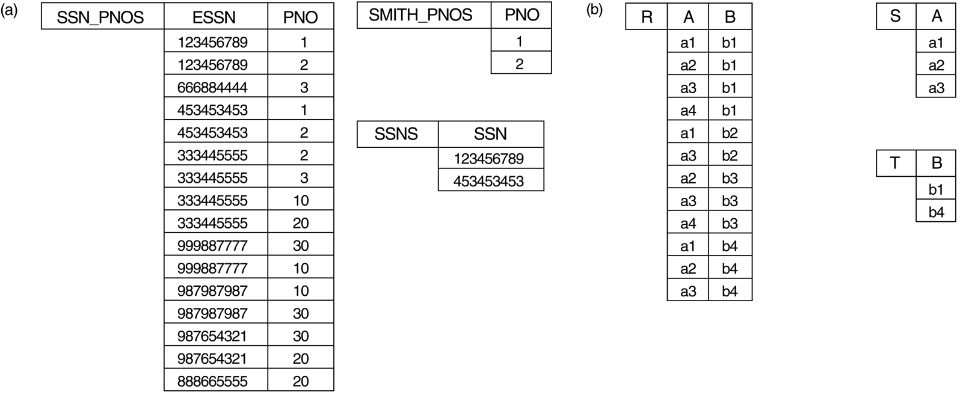
FIGURE≈6.8
The DIVISION operation. (a) Dividing SSN_PNOS by SMITH_PNOS. (b) T ← R ÷ S.

Slide 13
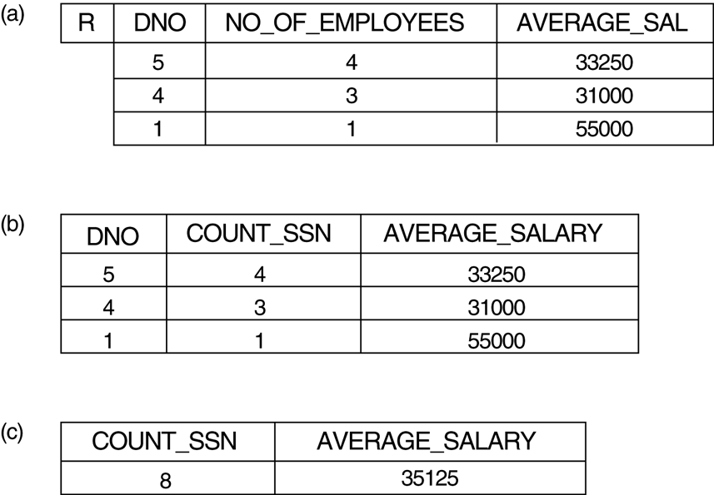
FIGURE≈6.9
The AGGREGATE FUNCTION operation.

Slide 14
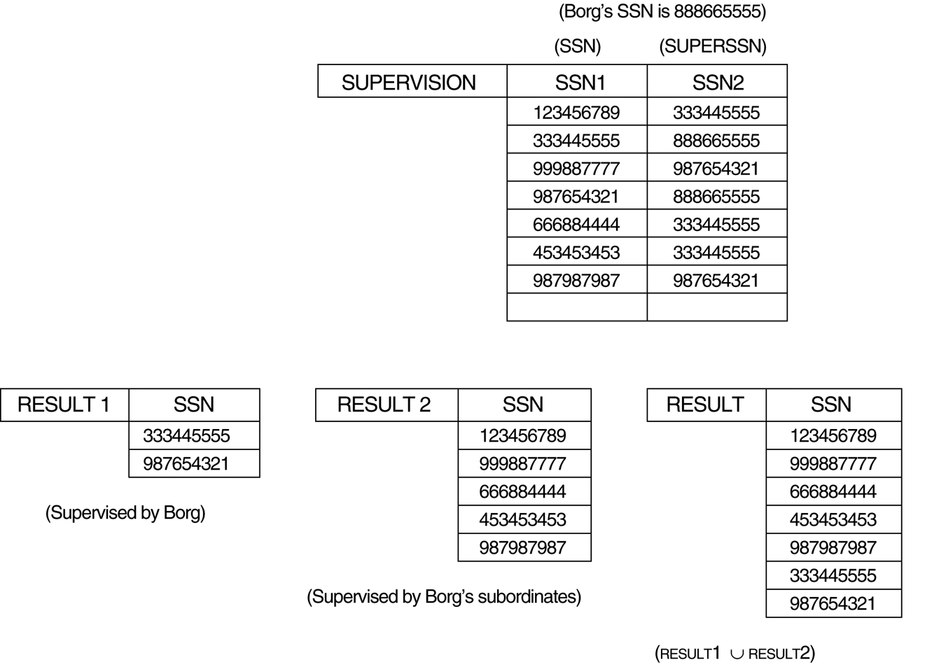
FIGURE≈6.10
A two-level recursive query.

Slide 15
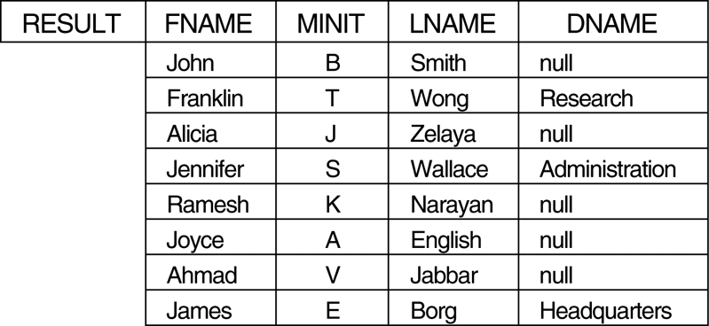
FIGURE≈6.11
The result of a LEFT OUTER JOIN operation.

Slide 16
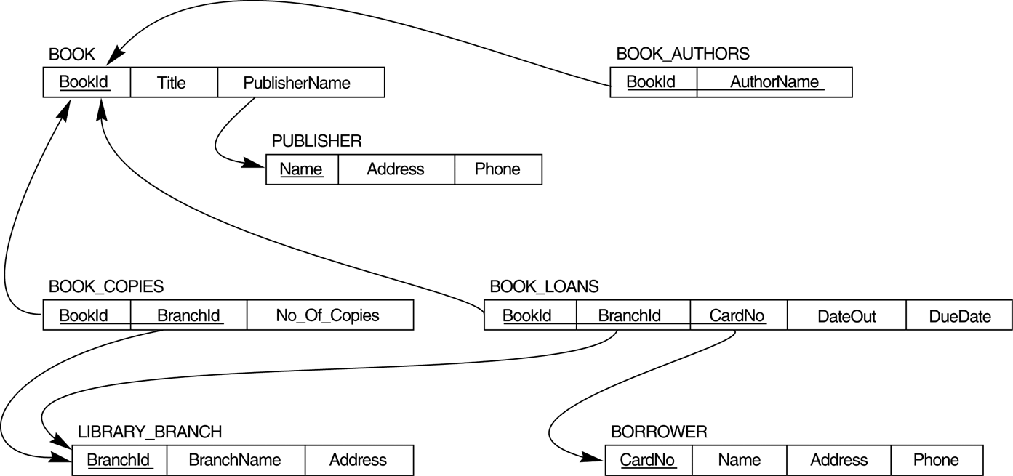
FIGURE≈6.12
A relational database schema for a LIBRARY database.

Slide 17
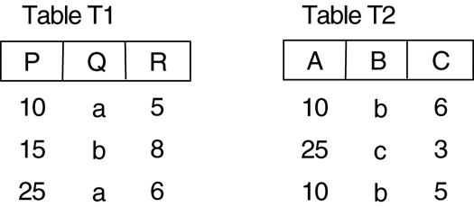
FIGURE≈6.13
A database state for the relations T1 and T2.

